Slide 1
Data Link Protocols 2 sliding window protocols

Slide 2
Sliding Window Protocols
A One-Bit Sliding Window Protocol
A Protocol Using Go Back N
A Protocol Using Selective Repeat
Protocols are full duplex
ACK is piggy-backed with data

Slide 3
Piggybacking
When sending data → send with it ACK for the next expected frame
Advantage: save bandwidth, packet processing capacity
Problem: If no data to send→ no ACK will be sent so will keep resending same data waiting for its ACK.
Solution: Use small timeout at the receiver of the data if it has no data to send , it times out and send an empty packet as ACK
Condition: timeout to send ACK <time out to retransmit

Slide 4
Sliding Window Protocols
Sending Window: range of sequence number sender permitted to send or already sent
Receiving Window: Range of sequence number receiver permitted to receive or
partially received
As a sender:
Takes a packet from the Network layer, and gives it the next available sequence number in the sending window.
If it receives an ACK on the lower end of the window, it advances it.
For example with window size=5 , If it sent all packets from 15→ 19, then cannot send another packet until receiving an ACK on the lower end(15).
As a receiver:
If received packet 3013 first → do not send any ACK.
If received packet 3011→ send ACK 3012 and advance lower end.
15 | 16 | 17 | 18 | 19
3011 | 3012 | 3013 | 3014 | 3015

Slide 5
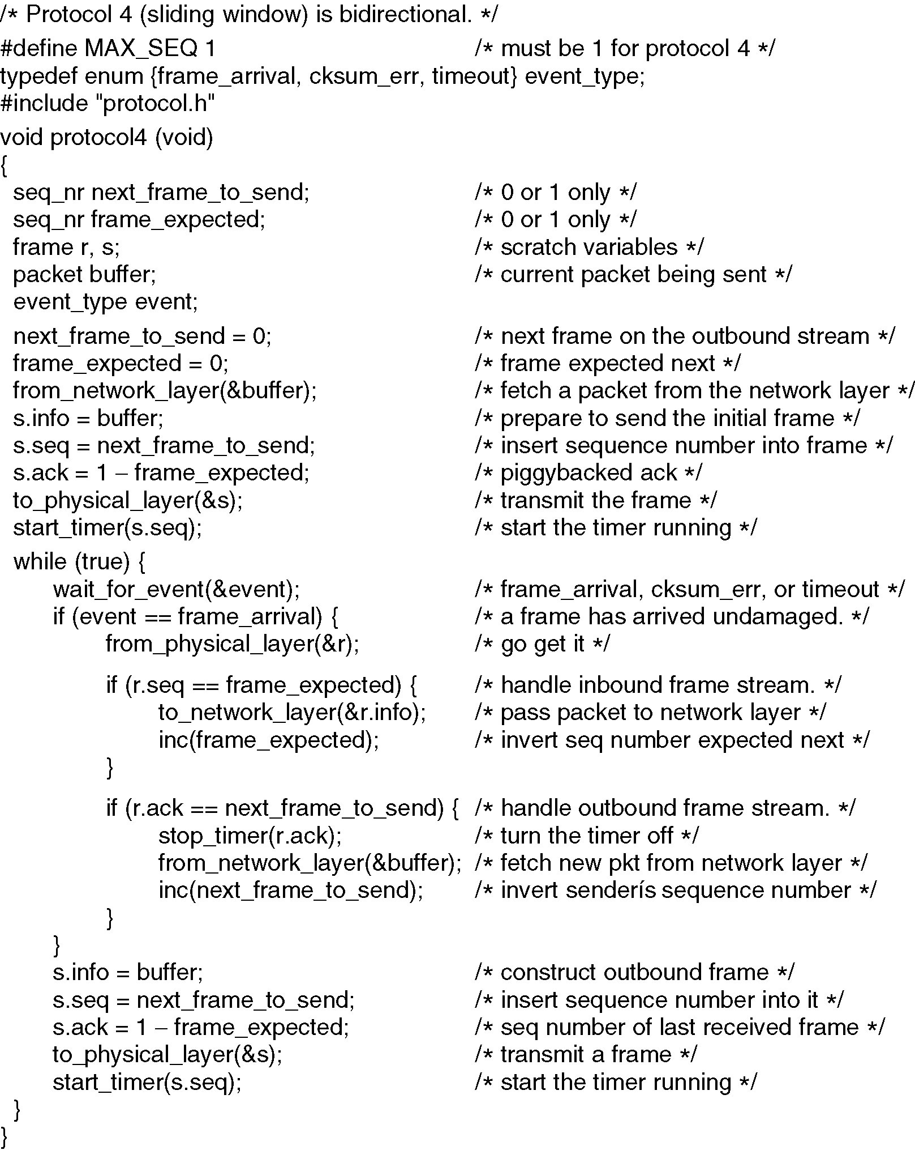
A One-Bit Sliding Window Protocol
This is equivalent to saying that ACK is the circular(frame expected-1)
Circular(x-1) = (x>0) ? (x--) : MAX_SEQ
Continued →

Slide 6
If (r.ack == 1- next_frame_to_send) {
ACK is the circular(frame expected-1)

Slide 7
Why do I have two variables, frame_expected and next_frame_to_send? In other words, can I calculate the value of one variable based on the value of the other?

Slide 8
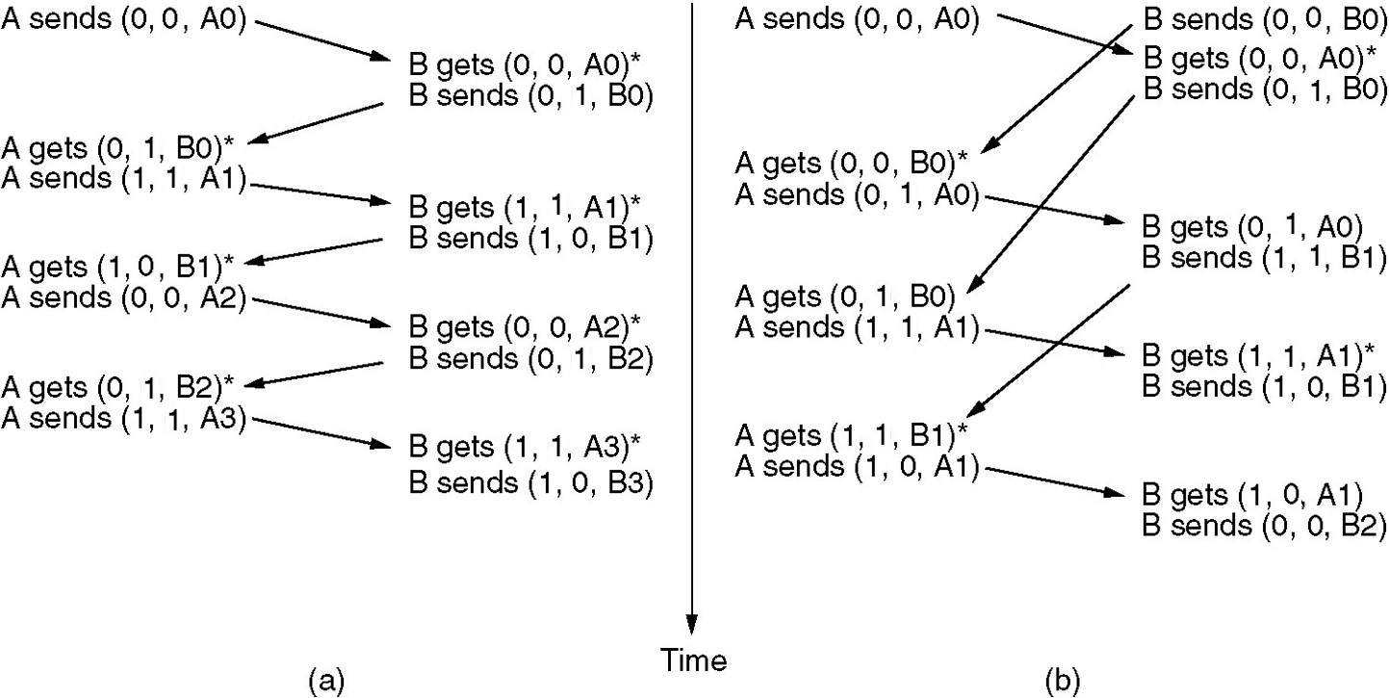
The notation is (seq, ack, packet number).
Two scenarios for protocol 4:
(a) Normal case: If one side sends a packet and it is received before the
other side sends a packet, the protocol works perfectly
(b) Abnormal case: If both sides send at the same time and the
frames cross
Every packet is sent twice
Protocol is still correct, but bandwidth is wasted

Slide 9
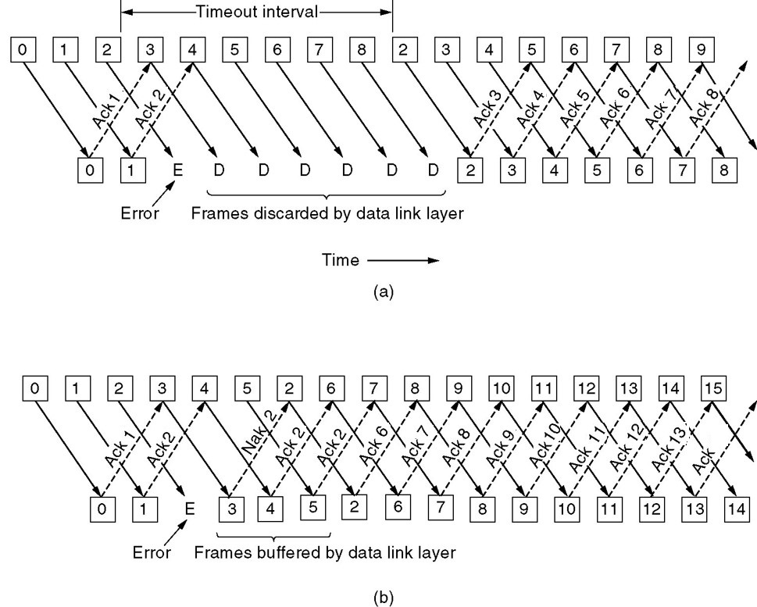
Go Back N vs. Selective Repeat

Slide 10
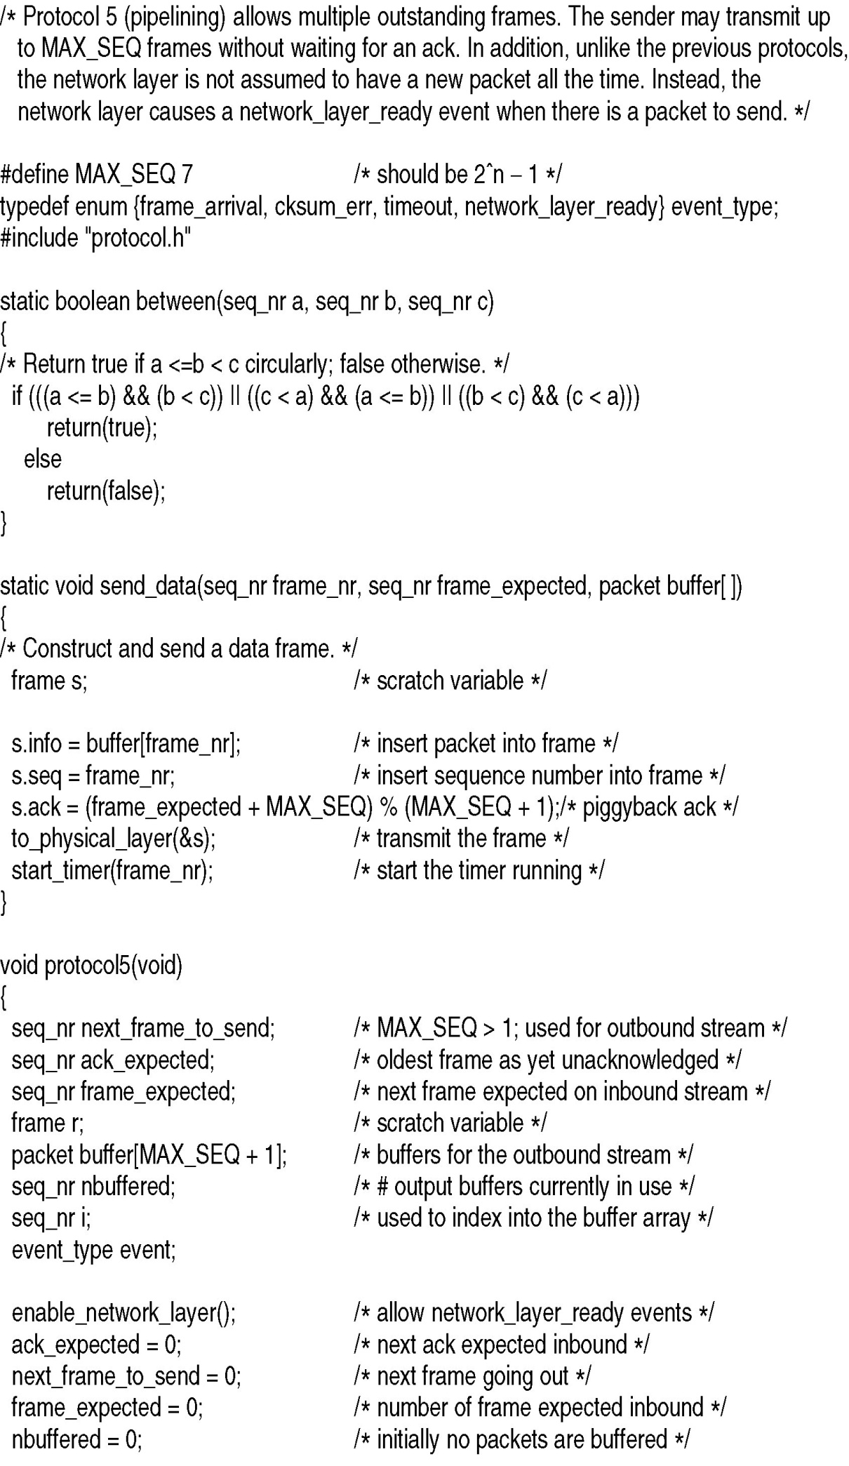
Sliding Window Protocol Using Go Back N
Window is between the sequence numbers a and c
a is considered earlier than c
Window is circular
Checks if b is within the window
Always piggyback ACK with every data packet
This means that one side may continue to get ACK even though it is not sending any traffic
Hence, for this protocol, we cannot rely on duplicate ACK to infer that a packet is lost because the receiver may be sending reverse traffic at a very high rate and hence the reason the sender is receiving duplicate ACK is because the sent packets are still traveling on the way NOT that the sent packets were lost
);
s.ack contains the sequence number of the next frame to be received
Think of s.ack as circular(frame_expected )
Remember that circular(x-1) = (x>0) ? (x--) : MAX_SEQ
(Re-)Start a separate logical timer for every sent sequence number
Continued →

Slide 11

Sliding Window Protocol Using Go Back N
Sender window is between ack_expected and next_frame_to_send
Receiver window is of fixed size 1
Receiver window is between frame_expected and (frame_expected+1)
Continued →

Slide 12
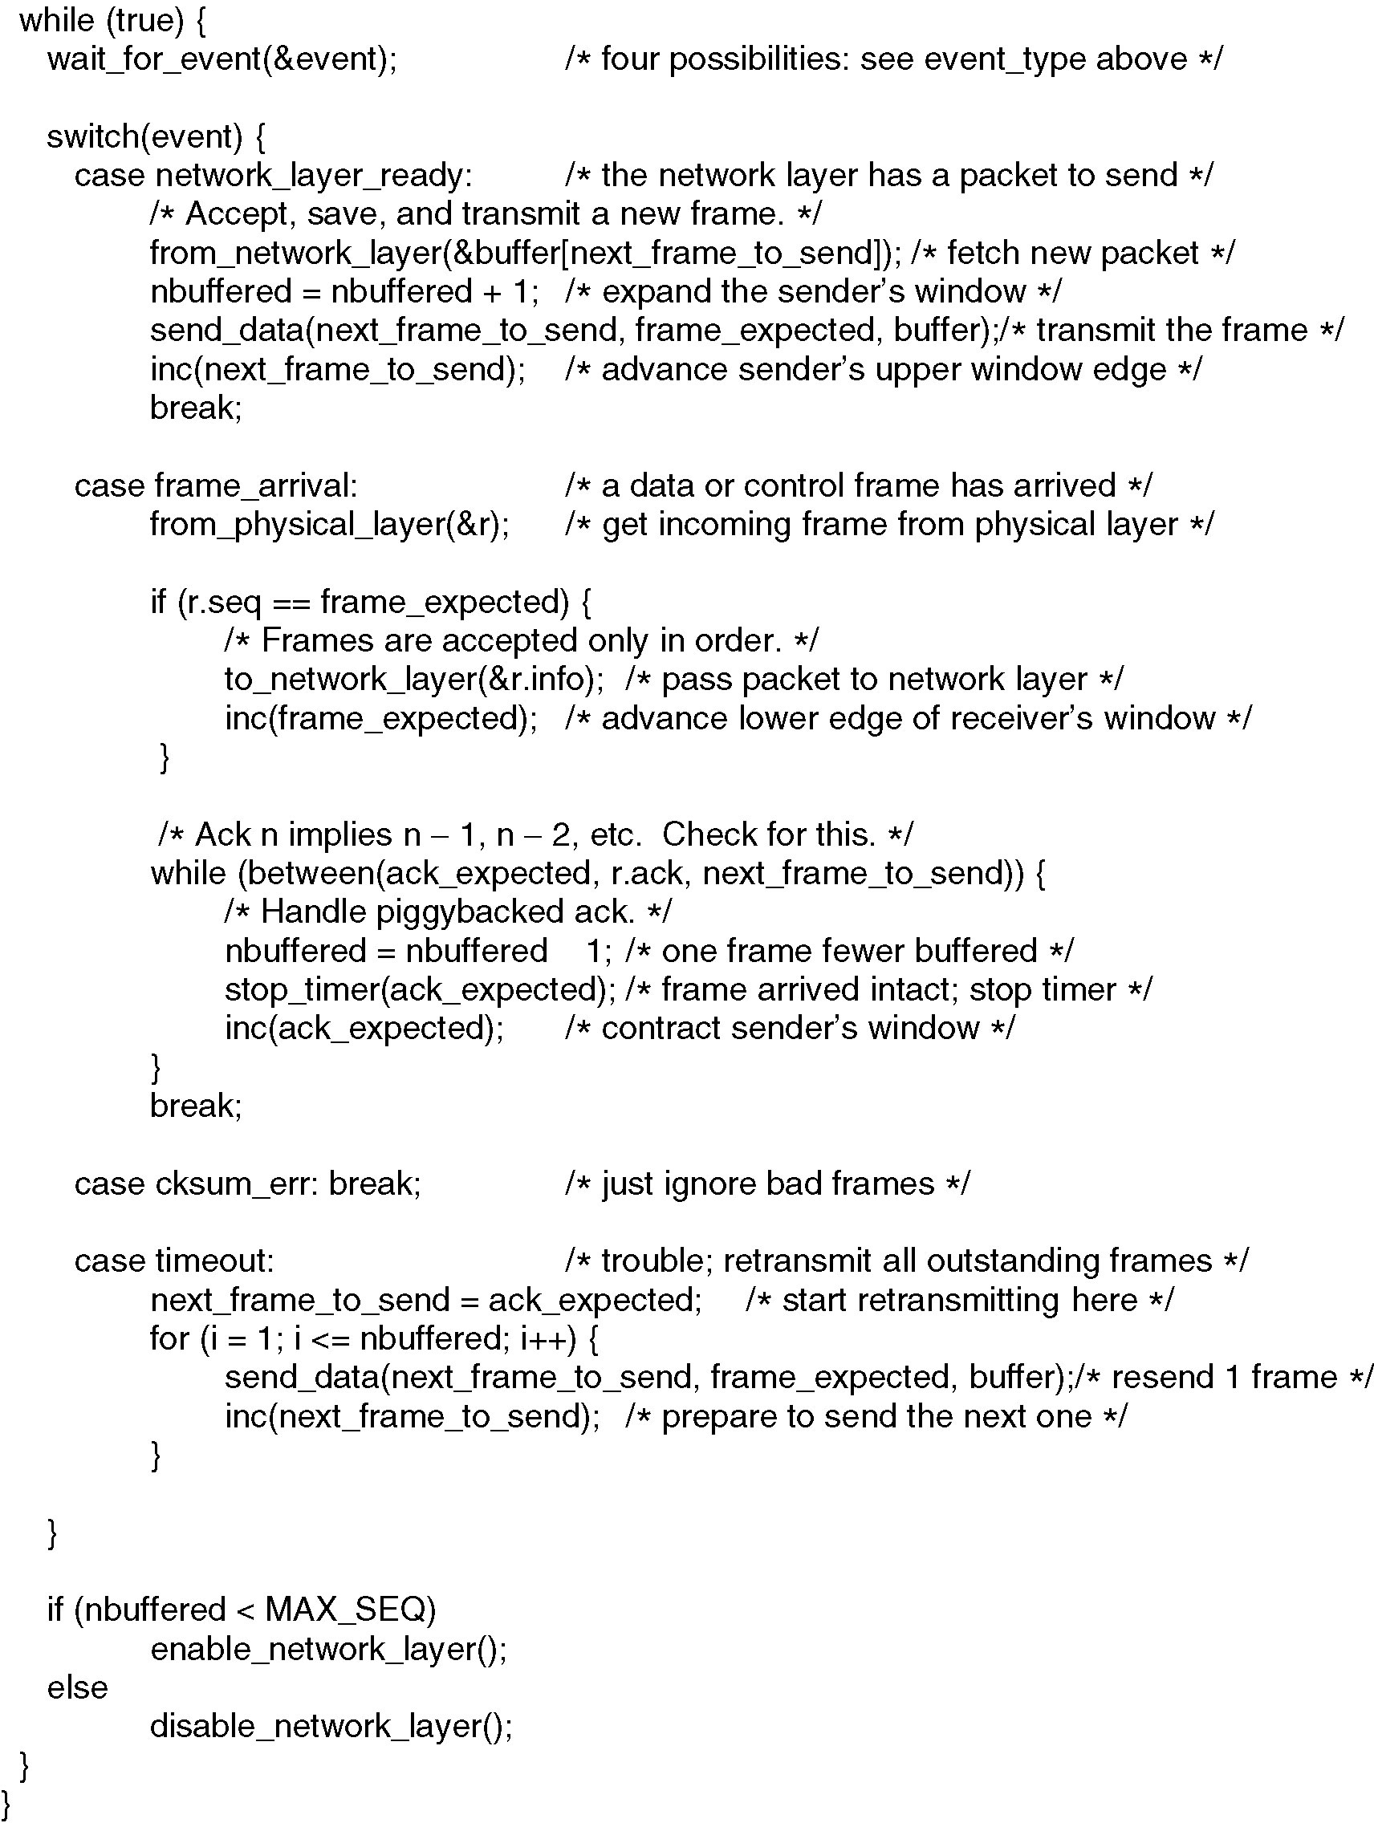
Sliding Window Protocol Using Go Back N
We try to send packet in every loop
If there is no other event, we send packets
We disable network layer when sender window is full
Hence we will always attempt to transmit the entire sender window
Advance upper end of sender’s window
⇒ increase sender’s
window
Advance Lower end of receiver window
Remember receiver window has fixed size 1
⇒ decrease receiver’s
window
Continued →

Slide 13
Sliding Window Protocol Using Go Back N
Outstanding packets
are between ack_expected and
next_frame_to_send
e.g. if Ack 3
Then packets 2,
1,0,…, arrived
What is the benefit of this while loop?
Advance lower end of
Sender’s window until it hits r.ack
⇒Reduce sender’s
window
⇒Free more buffers
Assume timeout because of frame loss
Retransmit all frames starting from the last ACKed frame because receiver has window size one
Max value of nbuffered is (MAX_SEQ)
Maximum number of outstanding packets is MAX_SEQ NOT (MAX_SEQ+1)
Because the network layer is enabled only if nbuffered is strictly less than MAX_SEQ
I.e. there are at most MAX_SEQ+1 distinct sequence numbers
Notes:
The while loop is advancing the lower end of the sender window until it is equal to r.ack, which the sequence number of last frame in the contiguous sequence of frames received by the user

Slide 14
Sliding Window Protocol Using Go Back N
Maximum Sender window size (maximum outstanding frames) must be MAX_SEQ(2^m-1) and not MAX_SEQ+1

Slide 15
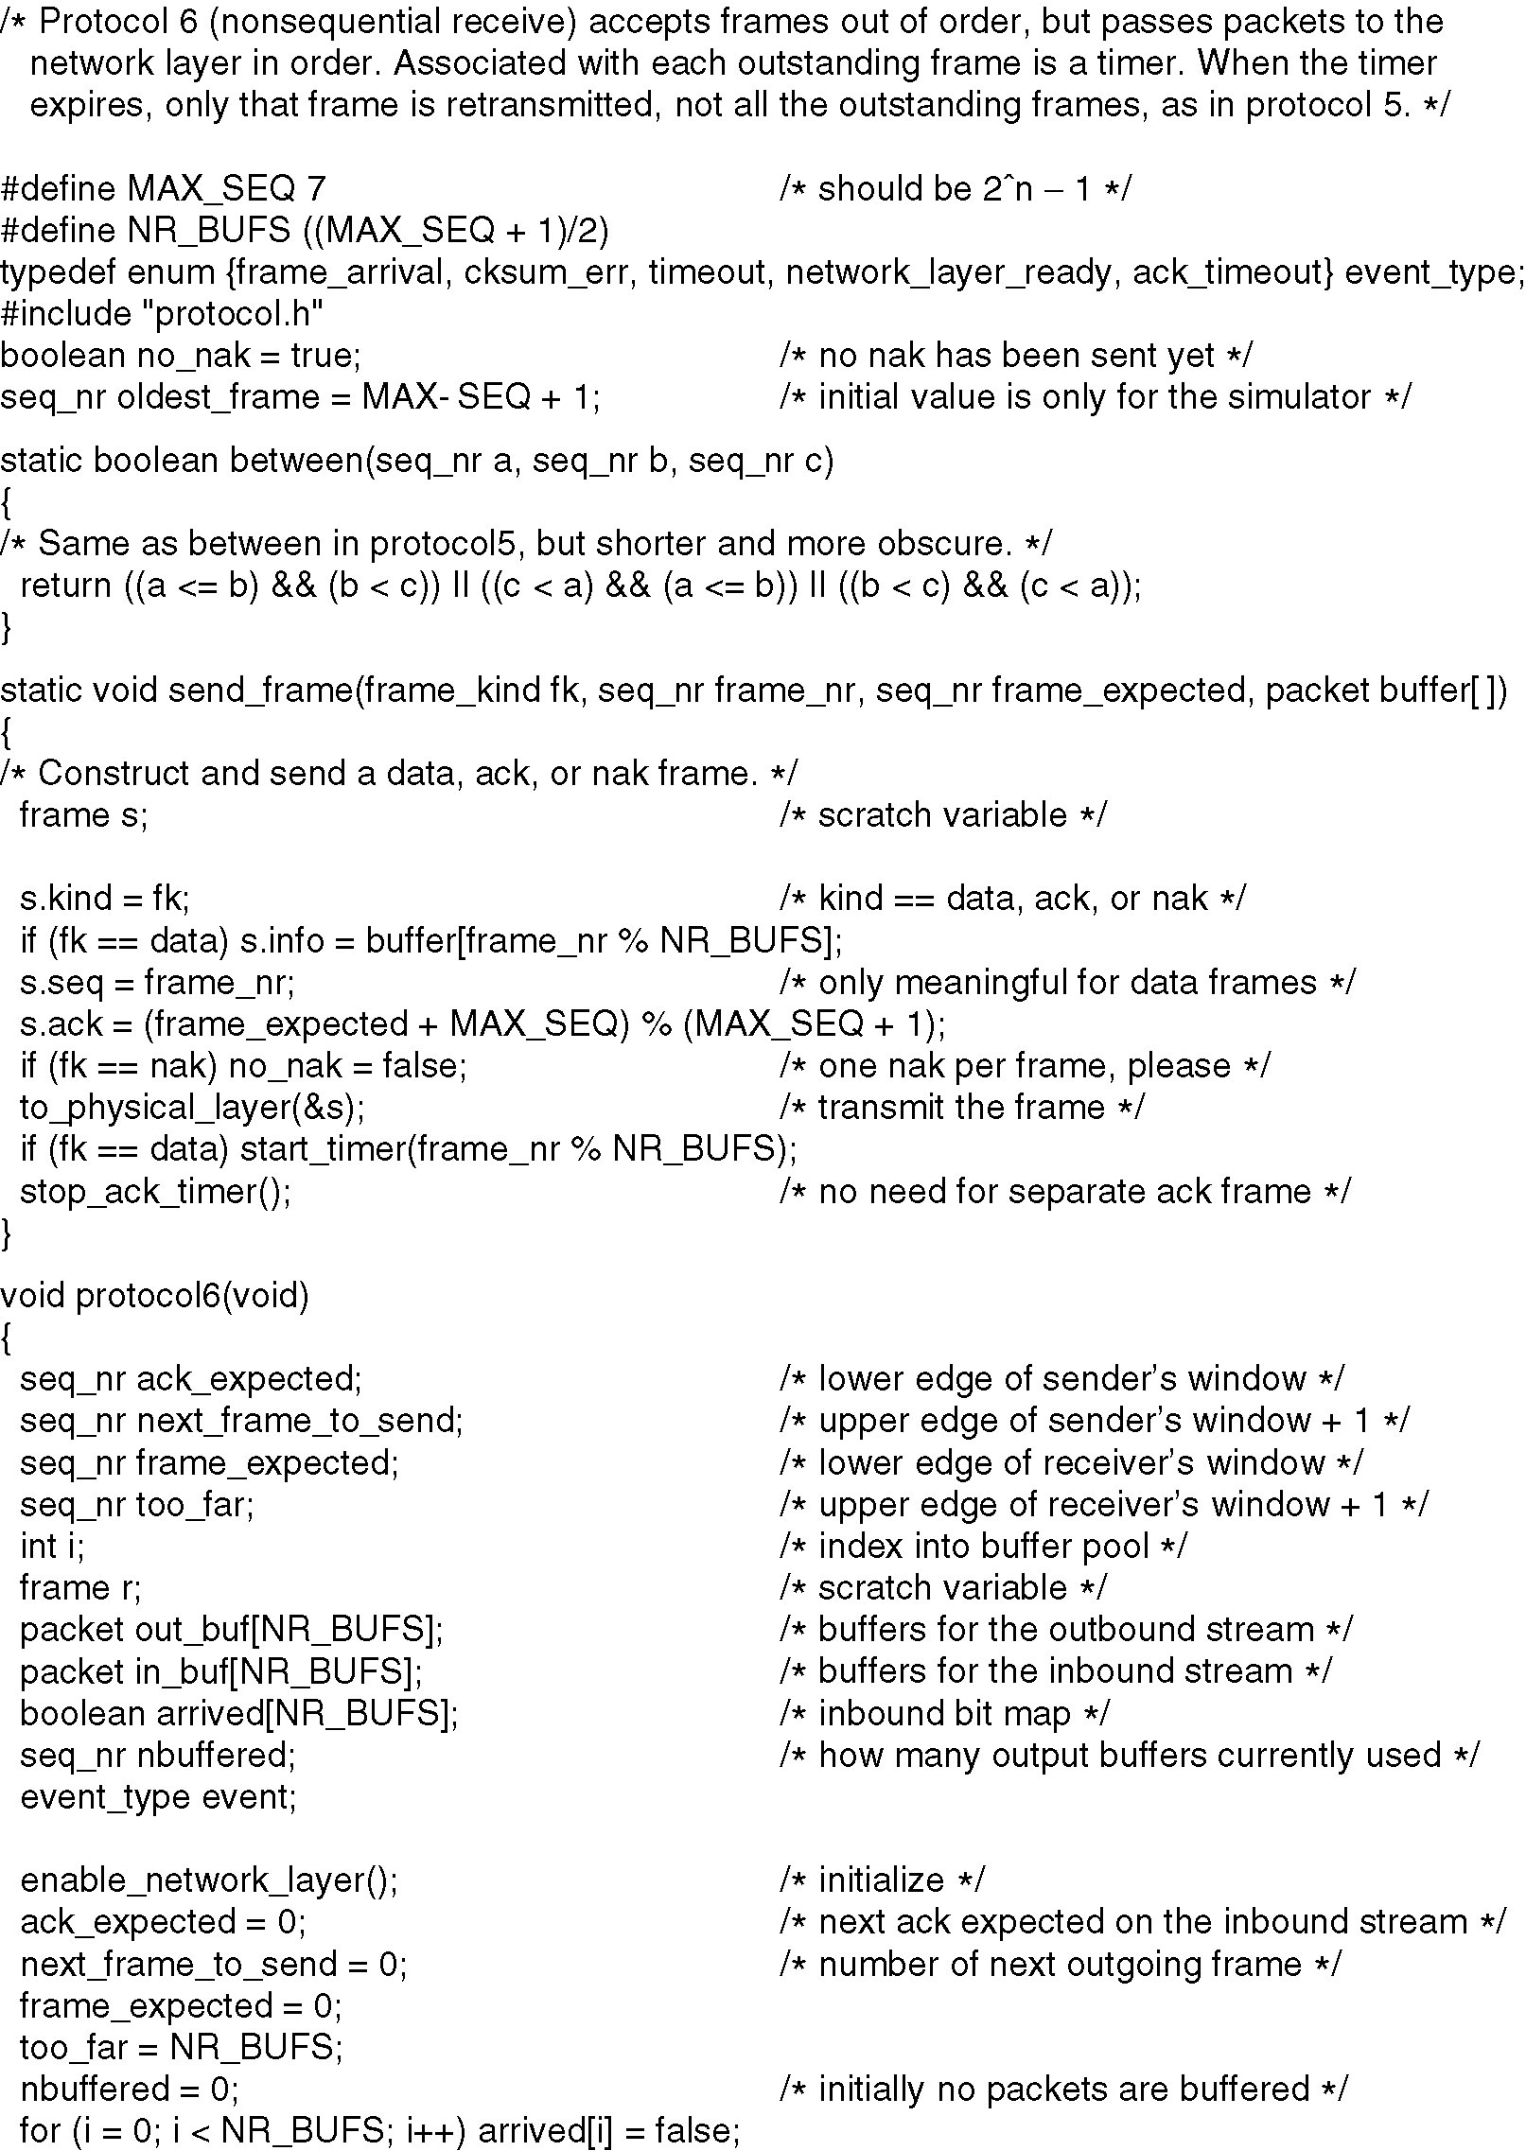
A Sliding Window Protocol Using Selective Repeat
Window size is half of MAX_SEQ
If frame type is not data, s.seq is ignored
⇒ We can put anything
s.ack contains the sequence number of the last received frame in the contiguous sequence of frames
you can think of s.ack as circular(frame_expected-1, MAX_SEQ)
);
If the packet that we are sending now is a NAK, then clear no_nak This way if the next packet is NOT frame_expected, we will start the ACK timer instead of sending a NAK one more time
Continued →

Slide 16
A Sliding Window Protocol Using Selective Repeat (2)
Need buffer at both sender and receiver
Sender window is between ack_expected and next_frame_to_send
Initially, receiver window is fixed between 0 and NR_BUFs
Continued →

Slide 17
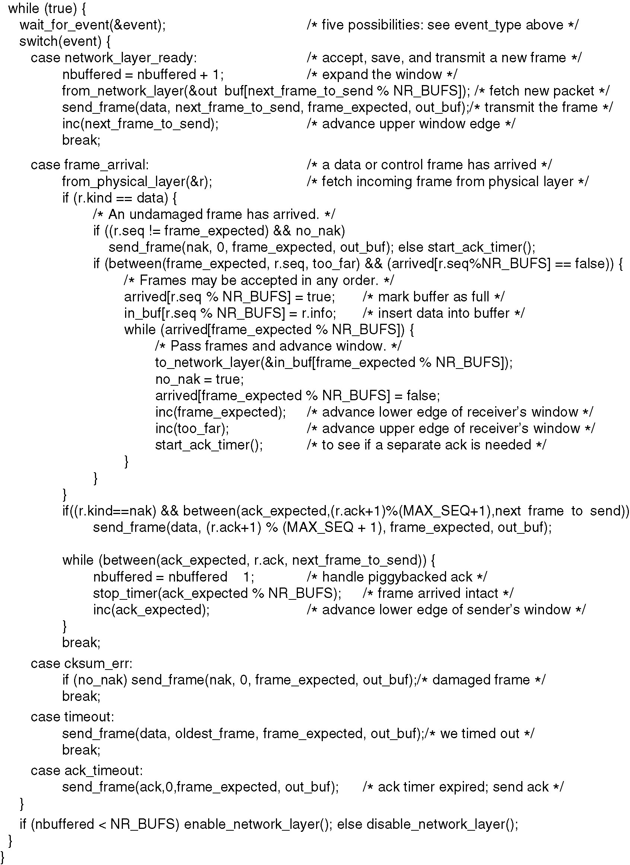
A Sliding Window Protocol Using Selective Repeat (3)
We did NOT receive the lower end of receive window
Send NAK immediately
Because send_frame() sets s.ack to circular(frame_expected-1) then the NAK frame contains the sequence number of the last received frame
Thus a when a sender receives a NAK, it should re-send the frame with sequence number circular(r.ack+1)
Restart ACK timer every time we receive out of order packet
Because we are sending a NAK, this value is meaningless
⇒ Put any thing
Deliver contiguous packet sequence to network layer starting from bottom of receiver window.
frame_expected is one more than the sequence number of the last received frame in contiguous sequence
Increment both lower and upper receiver window boundaries
⇒ Receiver window size always fixed at NR_BUFs
Allow sending NAK because we send NAK for frame_expected and frame_expected will be incremented soon
Reset ACK timer to the current time

Slide 18
A Sliding Window Protocol Using Selective Repeat (4)
When the other side sends a NAK, the other side sets the “ack” field to circular (frame_expected – 1).
Hence r.ack contains sequence number of the last received frame by the other side.
Thus a sender should re-send the frame whose sequence number is circular(r.ack+1)
Thus we have to test between for circular(r.ack+1)
ACK means all frames in the contiguous sequence of frames before and including ACKed frame have been received. Do the following between ack_expected and r.ack
Advance sender lower window
Free buffers
⇒Stop all retransmit timers
We assume that the timeout event causes the variable oldest_frame to be set according to the timeout that just expired
Re-send NAK for last frame received if we get a corrupted frame
On ACK timeout, we send ACK for the frame before bottom of the receiver window because frame_expected is one more than the sequence number of the last frame received in contiguous sequence
Because send_frame() sets s.ack to circular(frame_exptected-1), we will end up re-ACKing the last frame received in the contiguous sequence
Because we have ACK timeout
No need for reverse traffic
Solves the blocking problem of Go back N
Window size is NR_BUF ⇒ half of MAX_SEQ

Slide 19
A Sliding Window Protocol Using Selective Repeat (5)
Why is maxmimum WS ( number of buffers) is defined by (MAX_SEQ+1)/2?
Why ACK timer<<retransmit timer?

Slide 20
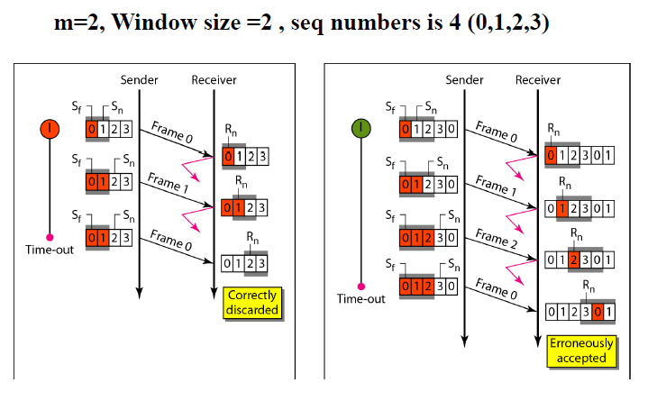
A Sliding Window Protocol Using Selective Repeat (5)

Slide 21
Link utilization
We want efficiency for sliding window protocols =100%
WS for 100% efficiency= (Tt+2Tp)/Tt
Minimum number of bits to distinguish between frames m=ceil(log2(WS for 100% efficiency))
=ceil(log2((Tt+2Tp)/Tt ))

